Slide 1




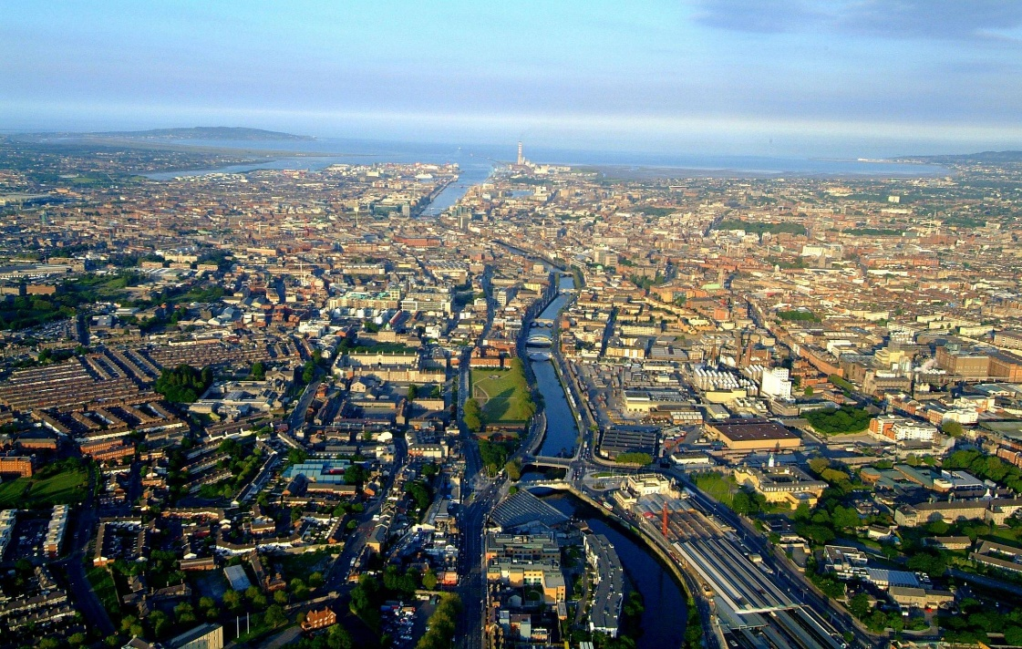
Workshop of H2020 geothermal research and innovation projects
Brussels, September 9°, 2016
Cheap-GSHPs Project
DISSEMINATION AND COMMUNICATION ACTIVITIES AND STRATEGY
WP9 Leader: ROMANIAN GEOEXCHANGE SOCIETY
Participants: All project partners
OVERVIEW OF THE PRESENTATION
DISSEMINATION AND COMMUNICATION ACTIVITIES PERFORMED SO FAR
FUTURE DISSEMINATION ACTIVITIES
SYNERGY WITH OTHER GEOTHERMAL PROJECTS

Slide 2
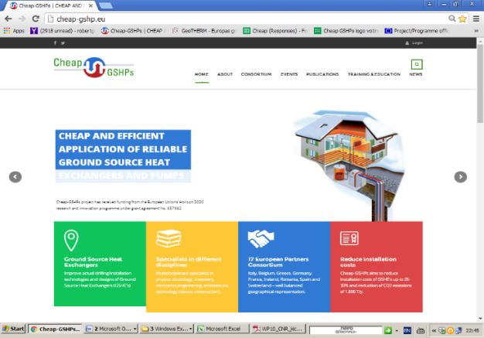
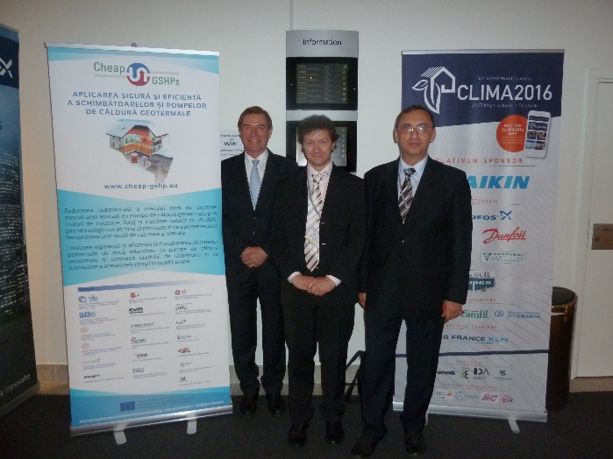

Workshop of H2020 geothermal research and innovation projects
Brussels, September 9°, 2016
1. DISSEMINATION AND COMMUNICATION ACTIVITIES PERFORMED SO FAR (1)
Project website: www.cheap-gshp.eu
The website contains public documents , such as:
  Leaflet
  Brochure
  Electronic newsletter #1
Roll-ups and posters in German and Romanian
International Workshop within CLIMA 2016 – REHVA Congress together with partners (May 2016)
Add in the REHVA Journal issue May 2016
Blog on the Smart Cities Information System
Cheap-GSHPs project page on UNESCO Venice
website;

Slide 3
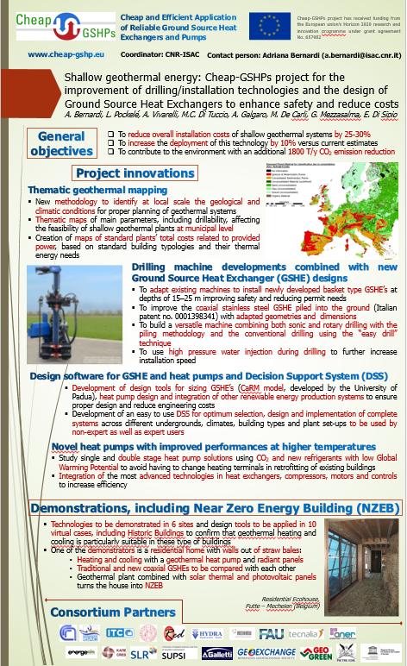
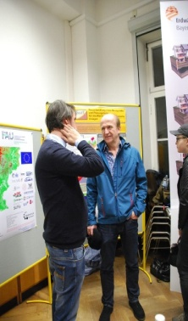
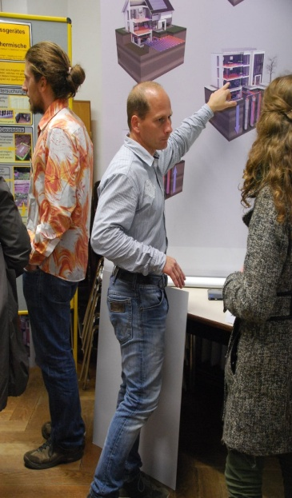
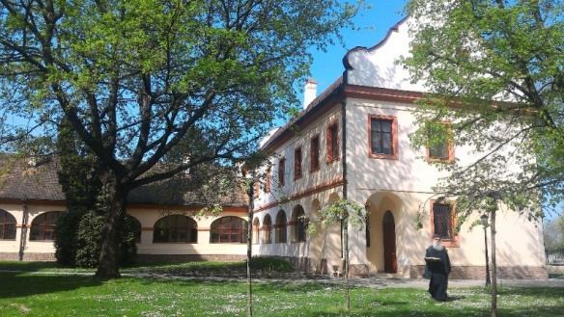
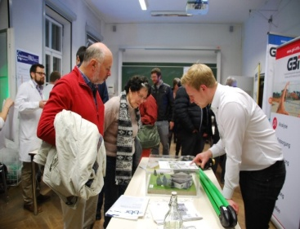
Workshop of H2020 geothermal research and innovation projects
Brussels, September 9°, 2016
1. DISSEMINATION AND COMMUNICATION ACTIVITIES PERFORMED SO FAR (2)
Papers and posters for a lot of national and international
events including: EGC 2016, CLIMA 2016 - REHVA Congress, European
Geosciences Union General Assembly 2016,
“Lange Nacht der Wissenschaften”Erlangen, etc.;
Continuing education courses “Best practices for the
execution of geothermal probes” and "Project and
dimensioning of geothermal probes“ (Lugano - June 2015)
UNESCO organized a mission to the monastery of
Bodani in Vojvodina- Serbia - virtual case study
WP9 – Robert Gavriliuc

Slide 4
Workshop of H2020 geothermal research and innovation projects
Brussels, September 9°, 2016
2. FUTURE DISSEMINATION ACTIVITIES
Permanent update of the website
Electronic newsletter – next issues every 6 months
Better penetration on Facebook, Twitter, etc…
International workshops – during important events
Training manual & Training courses
Technical brochure (in English and partners’ languages)
Case studies guidebook
Reports on project’s results
Scientific papers
High quality video with the main project results
Very short videos with main crucial passages and demonstration of operations
Final conference
WP9 – Robert Gavriliuc

Slide 5
Workshop of H2020 geothermal research and innovation projects
Brussels, September 9°, 2016
3. synergy with other geothermal projects (1)
Task 8.7 (Grant Agreement) starting in the third year – Activities involving the other winning projects inside the topic LCE 3 – 2014/2015: Demonstration of renewable electricity and heating/cooling technologies
Task Leader: CNR-ISAC and Participants: UNIPD-IE, ENERGESIS, RED, CRES,SLR
Highlights
  2 – 3 meetings with key partners of GeoTECH
    Explore synergies between technologies
    Build a “ plan for future common activity “
    Look for efficient and cost effective “ hybrid “ solutions
  Find ways to work together also after the project ends
  Diffuse the results together in associations and platforms
WP9 – Robert Gavriliuc

Slide 6
Workshop of H2020 geothermal research and innovation projects
Brussels, September 9°, 2016
3. synergy with other geothermal projects (3)
Common activities with other EU programs: Partner Energesis collaborates with GEOTeCH project
Info day during the European Geothermal Congress - September19-22, 2016, Strasbourg (poster presentation)
Presentation on the website of the Covenant of Mayors www.covenantofmayors.eu and participation at their actions
Presentation on the website of the Smart Cities Information System
Thank you for your attention!
WP9 – Robert Gavriliuc

