Slide 1























Workshop Geothermal panel meeting
8th September 2016
Brussels, September 8th, 2016
Cheap and efficient application of reliable
Ground Source Heat exchangers and Pumps
Project number: 657982- Project duration: 4 years – Start 1 June 2015
Total project budget: 5.804,847,50 € - Project budget financed: 4.844.652,00 €
Project presentation
Coordinator: Adriana Bernardi
National Research Council (CNR)
Institute of Atmospheric Sciences and Climate (ISAC)

Slide 2

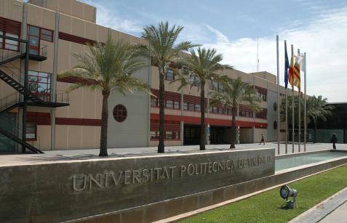
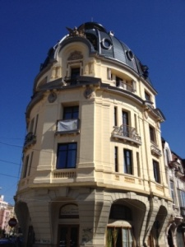


Workshop of H2020 geothermal research and innovation projects
Brussels, September 9°, 2016
1. Concept (1/2)
General objectives
To reduce total cost of ownership of shallow
geothermal systems by 25-30%
To increase the deployment of this technology by 10% versus
current estimates
To contribute to the environment with an additional
CO₂ emission reduction of 1800 T/y
To demonstrate the technologies in civil and
historical buildings (6 real sites and 10 virtual cases)
University of Valencia (Valencia, Spain)
Private house
(Bucarest, Romania
Adriana Bernardi

Slide 3
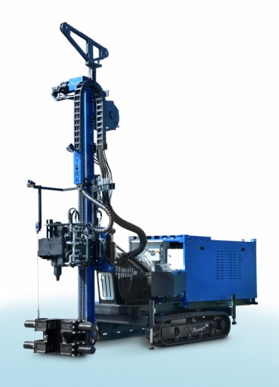
Workshop of H2020 geothermal research and innovation projects
Brussels, September 9°, 2016
1. Concept (2/2)
Project innovations
Thematic geothermal mapping at local scale for
better planning of geothermal systems
Drilling machine developments combined with new
Ground Source Heat Exchanger (GSHE) designs
to improve installation techniques, increase yield,
increase safety, reduce permit needs
Design software for GSHE and heat pumps and Decision Support System (DSS) for optimum selection, design and implementation of complete systems across different applications and soil conditions
Novel heat pumps with improved performances at higher temperatures to avoid having to change heating terminals in retrofitting of existing/historical buildings and to increase efficiency
Adriana Bernardi

Slide 4
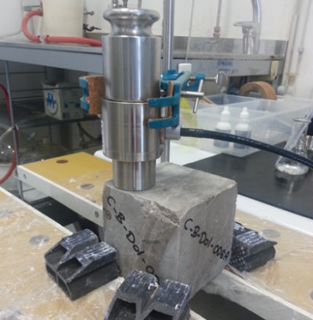
Workshop of H2020 geothermal research and innovation projects
Brussels, September 9°, 2016
2. Results (1/4)
Work progresses
Pan- European Geological data-set with drillability
information realized
Structure and costs of main types of GSHE’s
defined as reference basis
Heat basket developments achieved TRL 7
External diameter modification for more easy installation
New drilling tool and installation method
Two heat baskets installed in test field
Adriana Bernardi

Slide 5
Workshop of H2020 geothermal research and innovation projects
Brussels, September 9°, 2016
2. Results (2/4)
Co-axial GSHE developments achieved TRL 6
New drilling head for piling manufactured
Several simulations on design innovations
Prototypes of new inner tube produced
Innovations implemented in the field at full scale
Adriana Bernardi

Slide 6
Workshop of H2020 geothermal research and innovation projects
Brussels, September 9°, 2016
2. Results (3/4)
Conceptual heat pump study completed
DSS and Software design of building blocks progressing well
Final selection of real and virtual demonstration sites made
Pan-European legislative and regulatory analysis completed
Adriana Bernardi

Slide 7
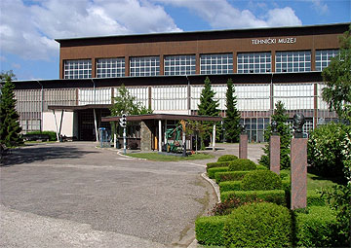
Workshop of H2020 geothermal research and innovation projects
Brussels, September 9°, 2016
3. Barriers
Demonstration case in historical site of balkans had to be changed due to unfavourable conditions to exploit shallow geothermal
Finacing missing infrastructure like terminals and paying for operating costs (both not foreseen in Cheap-GSHPs budget) is under discussion in Eastern Europe
Technical Museum of Zagreb (Zagreb,Croatia)
Adriana Bernardi

Slide 8
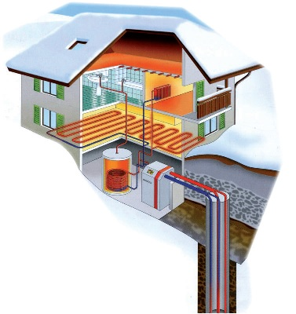
Workshop of H2020 geothermal research and innovation projects
Brussels, September 9°, 2016
Thank you for your attention!
www.cheap-gshp.eu
Contact:
Adriana Bernardi
CNR-ISAC
E-mail a.bernardi@isac.cnr.it

