Slide 1

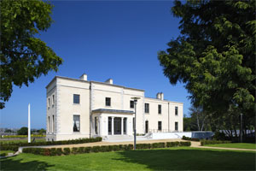
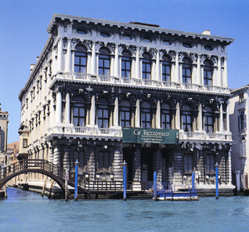
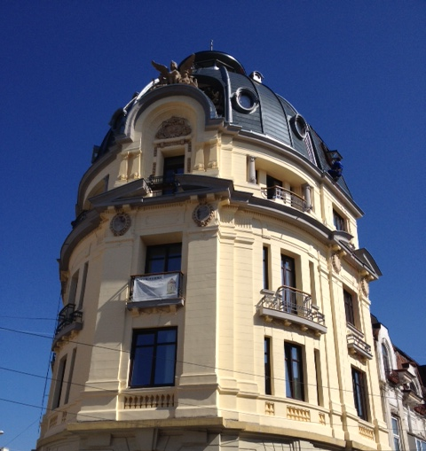
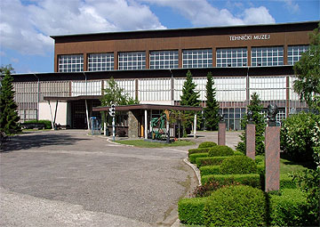
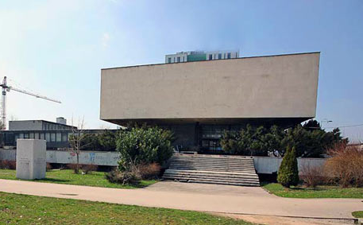
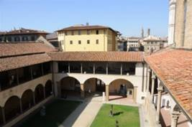
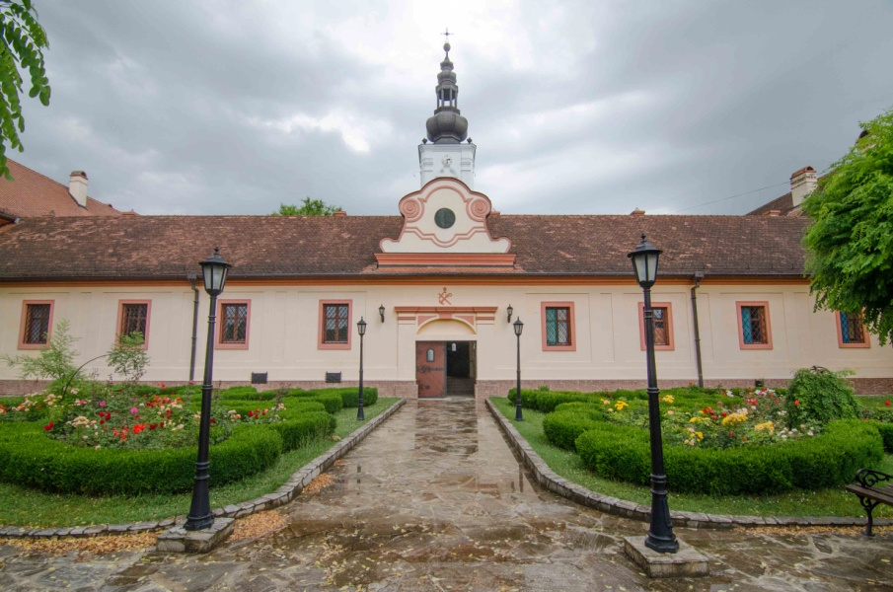



















Cheap and Efficient Application
of Reliable Ground Source Heat Exchangers and Pumps
Cheap-GSHPs project has received funding from the European union’s Horizon 2020 research and innovation programme under grant agreement No. 657982
www.cheap-gshp.eu
Coordinator: CNR-ISAC
Contact person: Adriana Bernardi (a.bernardi@isac.cnr.it)
Shallow geothermal technologies in Cultural Heritage: Cheap-GSHPs project
General objectives
To reduce overall installation costs of shallow geothermal systems by 25-30%
To increase the deployment of this technology by 10% versus current estimates
To contribute to the environment with an additional 1800 T/y CO₂ emission reduction
Thematic geothermal mapping at local scale for proper planning of geothermal systems
Drilling machine developments combined with new Ground Source Heat Exchanger (GSHE) designs to improve installation techniques and costs saving, ensure higher safety, reduce permit needs
Design software for GSHE and heat pumps and Decision Support System (DSS) for optimum selection, design and implementation of complete systems across different conditions
New heat pumps with improved performances at higher temperatures to avoid having to change heating terminals in retrofitting of existing/historical buildings and to increase efficiency
Project innovations
Demonstrations in Historical Buildings
Technologies demonstrated in 6 real sites and tools to be applied in 10 virtual cases
Notable cultural-historical buildings to test the innovative solutions
Set-up of specific operational plan to identify preservation of architectural integrity and aesthetical value, capacity to meet the specific energy and regulatory obligations
Development of final recommendations for a wide-spread and successful introduction of the technologies into the shallow geothermal market applied to historical buildings
Concrete proof how innovative shallow geothermal systems may successfully overpass conservational constraints and barriers to geothermal application in cultural sites
Belfield House at University College (Dublin, Ireland)
Private historical building (Bucharest, Romania)
a)
Ca’ Rezzonico and Ca’ Lupelli (Venice, Italy)
d)
e)
Real demo:
a & b
Technical Museum of Zagreb (Zagreb, Croatia)
b)
Virtual demo: c , d, e, f & g
Historical Museum of Bosnia and Herzegovina (Sarajevo, BiH)
f)
Complex of Santa Croce (Florence, Italy)
c)
Consortium Partners
Orthodox Bođani Monastery (Bođani, Serbia)
g)

